Slide 1
Digital portfolio
Name : B.Nithya
Register no. : 222403838
NIMID no. : asumn293222403838
Department : computer science
College. : vidhya saga women’s college
Notes:
Digital portfolio

Slide 2
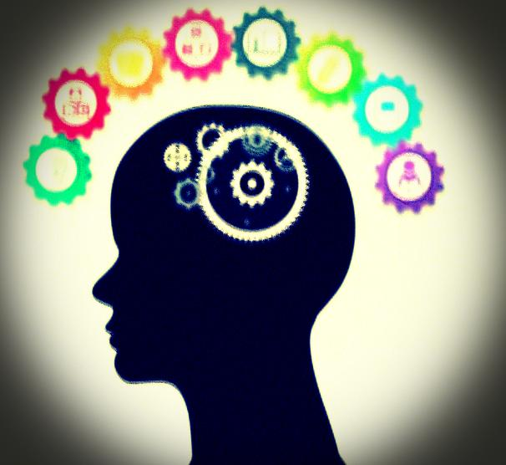
Digital portfolio

Slide 3

AGENDA
Problem statement
Project overview
End user
Tools and technologies
Portfolio design and Layout
Future and Functionality
Result and screenshot
Conclusion
Github Link

Slide 4
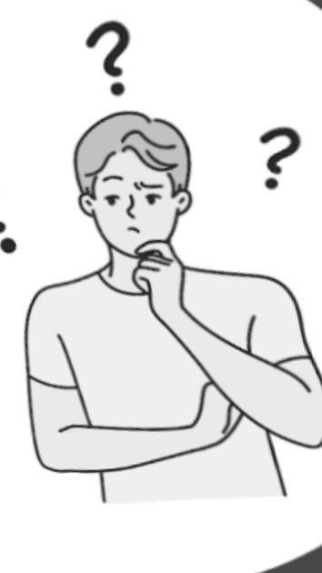
Problem statement
problem statement is a clear, concise description of an issue that needs to be addressed or solved
Identifies the problem – what the issue is.
Explains the context – why the problem exists.
Shows the impact – who or what is affected.
Highlights the need – why it is important to solve.
Sets direction – guides the goals or objectives of the project

Slide 5
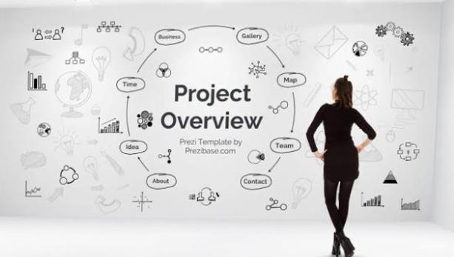
PROJECT OVERVIEW
A Project Overview is a brief summary that explains the purpose, scope, and goals of a project
It usually includes:
Introduction – what the project is about.
Purpose – why the project is being developed.
Scope – what the project will cover and deliver.
Objectives – the main goals to be achieved.
Target Users – who will benefit from the project.
Expected Outcome – what results the project aims to prodction

Slide 6
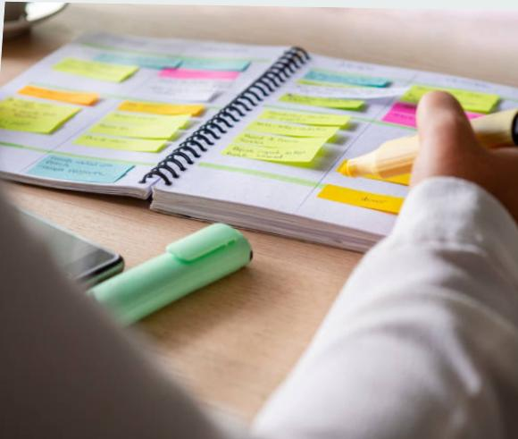
WHO ARE THE END USERS?
End Users are the people who will directly use and benefit from the final product, service, or system. They are the target audience for whom the project is being designed and developed.
They are not always the same as clients, developers, or stakeholders.
They are the actual users who interact with the project in Real life
The end users are recruiters, employers, clients, or collaborators who visit the portfolio to evaluate skills, view projects, and connect with the owner.

Slide 7
TOOLS AND TECHNIQUES
Tools and Technologies in a project refer to the software, programming languages, frameworks, libraries, and platforms that are used to design, develop, test, and deploy the project.
Tools → Software or applications that help in development (e.g., VS Code, Figma, GitHub).
Technologies → The actual programming languages, frameworks, or platforms that power the project (e.g., HTML, CSS, JavaScript, React, Node.js
Tools: Visual Studio Code, Git & GitHub, Figma, Chrome DevTools.
Technologies: HTML5, CSS3, JavaScript, React.js, Bootstrap/Tailwind CSS.
Would you like me to write this section in your agenda format (like a neat ready-made answer for your project report)?

Slide 8
POTFOLIO DESIGN AND LAYOUT
Portfolio Design and Layout refers to the visual structure, organization, and presentation of a portfolio website or document. It focuses on how information is arranged so that it is easy to navigate, visually appealing, and effectively showcases skills and projects.
Key points include:
Design – The overall look and feel (colors, fonts, themes, branding).
Layout – The arrangement of sections (About Me, Skills, Projects, Contact, etc.).
Navigation – How users move between different sections/pages.
User Experience (UX) – Ensuring the portfolio is simple, attractive, and professional.

Slide 9
FEATURES AND FUNCTIONALITY
Home page with personal introduction
Skills showcase section
Projects gallery with GitHub/demo links
Contact form and social media integration
Responsive design (works on mobile, tablet, desktop)
Functionality:
Clicking a project card opens detailed info or redirects to GitHub.
Contact form allows users to send messages directly.
Responsive layout automatically adjusts for different screen sizes.

Slide 10
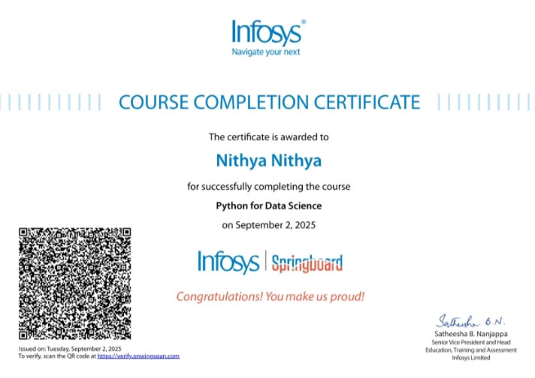
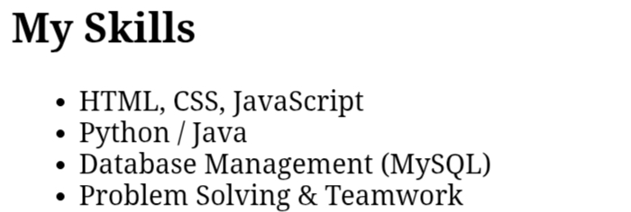
Skil

Slide 11
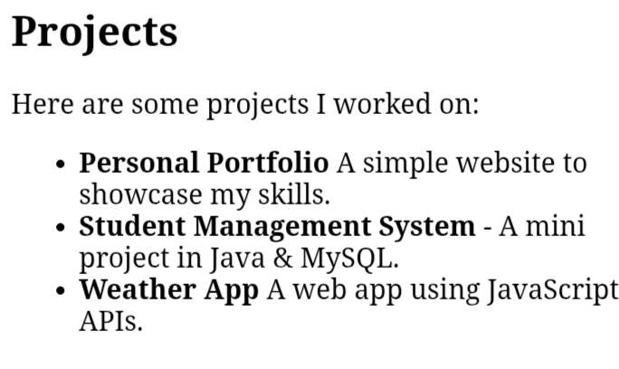
Project

Slide 12
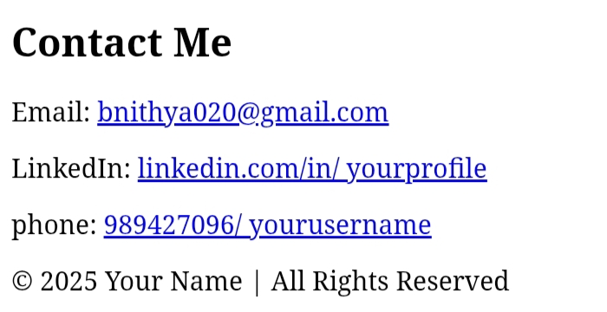
Contact

Slide 13
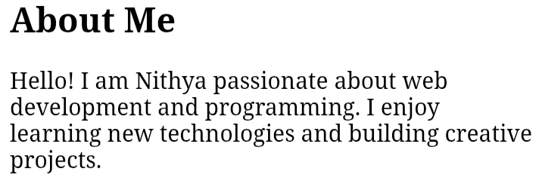
About me

Slide 14
Conclusion
The creation of this digital portfolio has provided a structured way to showcase my skills, knowledge, and projects in a professional format. It highlights my problem-solving abilities, technical expertise, and creativity while demonstrating my capability to work with modern tools and technologies.
This portfolio not only reflects my academic and professional journey but also serves as a dynamic platform that can grow with me. By including real-world projects, features, and designs, it helps present my strengths to potential employers, educators, and collaborators.
In the future, I plan to continuously update this portfolio with new projects, improved designs, and advanced functionalities to keep it relevant and engaging. Overall, this digital portfolio is not just a representation of my work—it is a step toward building my career and achieving my long-term goals.

